Slide 1


The Use of Scanning Electron Microscopy with Energy Dispersive Spectroscopy in Forensic Sciences
ANIKET SHANKER MISHRA MSE 550
DUE DATE: 04/15/23

Slide 2
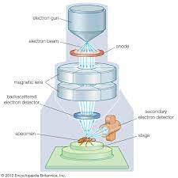
Introduction to Scanning Electron Microscopy (SEM)
High-resolution imaging:
SEM allows for the generation of high-resolution images of the surface of a sample, which can reveal details at the nanoscale level.
SEM can provide images in three dimensions, unlike traditional light microscopy.
SEM can provide information about surface topology, morphology, and composition.
Elemental analysis:
SEM can be used to perform elemental analysis of a sample.
Secondary electrons, backscattered electrons, and X-rays can all be used to detect the elements present in a sample.
Elemental mapping can be performed to determine the distribution of elements within a sample.
"Scanning Electron Microscopy in Forensic Science" by C. P. Sharma and P. N. Shukla, Journal of Forensic Research, 2014.

Slide 3
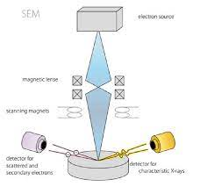
Introduction to Energy Dispersive Spectroscopy (EDS)
Elemental Analysis:
EDS is a powerful analytical technique that provides information on the elemental composition of a sample.
EDS detects X-rays emitted by the sample when it is bombarded with a focused beam of electrons.
The energy of the X-rays is characteristic of the elements present in the sample, allowing for their identification.
Quantitative Analysis:
EDS can provide quantitative information on the concentration of elements in a sample.
The intensity of the X-rays detected is proportional to the number of atoms of each element present in the sample.
Imaging:
EDS can be used in conjunction with Scanning Electron Microscopy (SEM) to provide elemental maps of a sample.
Goldstein, J. I., Newbury, D. E., Echlin, P., Joy, D. C., Romig, A. D., Lyman, C. E., ... & Fiori, C. (2018). Scanning electron microscopy and X-ray microanalysis. Springer.

Slide 4
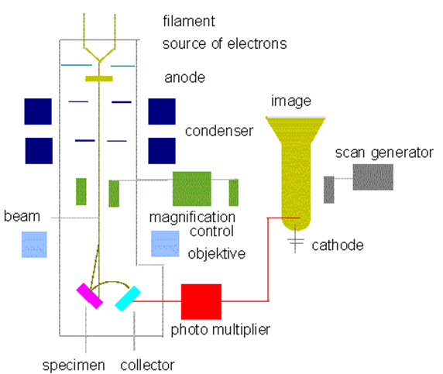
Importance of SEM-EDS in forensic sciences
Trace Evidence Analysis:
SEM and EDS are commonly used in forensic science to analyze trace evidence found at a crime scene, such as fibers, hair, and paint chips.
Fire Debris Analysis:
SEM and EDS can be used to analyze fire debris, such as charred materials and ash, to determine the cause and origin of a fire.
Gunshot Residue Analysis:
SEM and EDS can be used to analyze gunshot residue, which can provide valuable information in forensic investigations.
Tool Mark Analysis:
SEM and EDS can be used to analyze tool marks left at a crime scene, such as those made by a screwdriver or a pair of pliers.
"Applications of Scanning Electron Microscopy and Energy Dispersive X-ray Analysis in Forensic Investigations" by K. R. Koirala et al., Journal of Forensic Sciences, 2009.

Slide 5
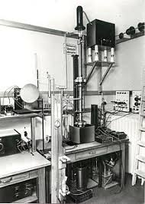
Background
Evolution of SEM-EDS usage in analysis
SEM-EDS technology has been used for over 50 years for the analysis of materials, but early instruments had limited resolution and sensitivity.
Advancements in computer technology, imaging software, and electron sources have greatly improved the capabilities of SEM-EDS instruments.
The integration of SEM-EDS with other techniques has expanded the range of materials that can be analyzed.
Recent developments in detector technology have improved the speed and sensitivity of SEM-EDS instruments.
How it is different from the past
Increased sensitivity and accuracy
Faster analysis
More diverse applications
Improved imaging capabilities
Parr, J. W. K., & Sullivan, N. (2018). The evolution of scanning electron microscopy and energy dispersive X-ray spectroscopy for the analysis of materials. Microscopy Today, 26(6), 28-33.

Slide 6
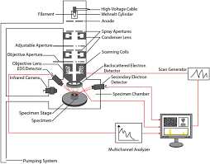
Tool components of SEM-EDS in Forensic Sciences
Electron Gun: produces a beam of electrons used to scan the sample surface and generate images.
Electron Optics: controls the trajectory of the electron beam to focus it onto the sample and create an image.
Scanning System: moves the electron beam across the sample surface to generate images and analysis data.
EDS Detector: collects X-rays emitted from the sample during analysis and converts them into signals for data analysis.
X-ray Analyzer: identifies the elements present in the sample by measuring the energy of the X-rays emitted during analysis.
Control and Analysis Software: allows for control of the instrument and data analysis, including generating images and element analysis data.
"Scanning Electron Microscopy with Energy Dispersive X-ray Spectroscopy (SEM-EDS) in Forensic Investigations" by S. Bahrami, M. Geranmayeh, and M. Ghambari, Journal of Forensic Sciences, 2020, vol. 65, no. 5, pp. 1525-1536.

Slide 7
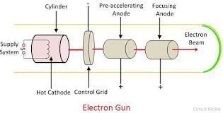
Beam used in Electron Gun
The beam used in an electron gun is a stream of electrons.
Electrons are negatively charged subatomic particles that are much smaller than the atoms they orbit.
The beam is generated by heating a filament or cathode, which causes electrons to be emitted from its surface through a process called thermionic emission.
The emitted electrons are then accelerated toward a positively charged anode using an electric field.
The resulting beam can be focused and directed using various electromagnetic lenses and deflectors.
"Introduction to Scanning Transmission Electron Microscopy" by Stephen J. Pennycook and Angus I. Kirkland, Springer, 2019.

Slide 8
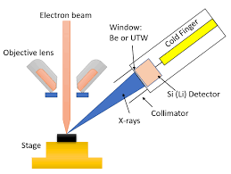
Importance of EDS Detector
An EDS detector is used to detect and measure X-rays emitted by a sample when it is bombarded with electrons in a scanning electron microscope (SEM).
The X-rays carry information about the chemical composition of the sample, allowing the detection of elements from boron (Z=5) to uranium (Z=92).
EDS detectors provide qualitative and quantitative analysis of the elements present in the sample, allowing identification of unknown materials and determination of their chemical composition.
EDS detectors provide high spatial resolution chemical analysis, allowing the mapping of chemical composition across the surface of the sample.
EDS detectors are non-destructive, allowing for repeated measurements on the same sample and preservation of the sample for further analysis.
"Practical Scanning Electron Microscopy: Electron and Ion Microprobe Analysis" by David C. Bell and Natasha Erdman, CRC Press, 2019.

Slide 9
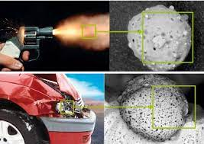
Applications of SEM-EDS in Forensic Sciences
Analysis of gunshot residue: SEM-EDS is used to detect and analyze particles of gunshot residue from a crime scene to identify the type of firearm and ammunition used.
Examination of paint chips: SEM-EDS is used to analyze paint chips found at a crime scene to identify the make, model, and year of the vehicle involved in an accident or crime.
Analysis of fibers: SEM-EDS is used to analyze the chemical composition of fibers found on a victim or at a crime scene to determine their origin and match them to a suspect or location.
Drug analysis: SEM-EDS is used to analyze drug samples to identify their chemical composition and purity, aiding in drug trafficking investigations and prosecutions.
Forensic anthropology: SEM-EDS is used to analyze skeletal remains for identification and determining the cause of death.
"Scanning Electron Microscopy and X-ray Microanalysis: Third Edition" by Joseph Goldstein, Dale Newbury, Joseph Michael, and Nicholas Ritchie, Springer, 2003.

Slide 10
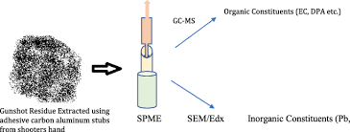
Case study 1: Gunshot Residue Analysis
SEM-EDS was able to identify and differentiate between gunshot residue particles and other environmental particles that may have been present on the suspect's hands.
The SEM-EDS analysis provided quantitative results, which could be used to estimate the number of shots fired and the distance between the gun and the victim.
The information provided by the SEM-EDS analysis was critical in refuting the defense's claims that the residue could have been transferred from other sources, such as a car battery or fireworks.
SEM-EDS is commonly used in gunshot residue analysis and is a powerful tool in criminal investigations.
A. S. A. Mohamad, M. A. Abd Rahman, M. Y. A. Rahman, M. S. Othman, & M. Z. Abidin. (2015). Analysis of gunshot residue on hands by scanning electron microscopy–energy dispersive X-ray spectrometry (SEM-EDX). Journal of Forensic and Legal Medicine, 29, 8-13.

Slide 11
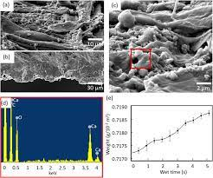
Case 2 study: Fiber Analysis
SEM-EDS was able to identify the elemental composition of the fibers, which provided valuable information for comparison to other fibers found at the crime scene or in the suspect's home.
The SEM-EDS analysis was able to differentiate between different types of fibers, such as natural fibers like wool or cotton and synthetic fibers like polyester or nylon.
The fiber analysis using SEM-EDS was able to exclude other potential sources of the fibers, such as common clothing or carpet fibers, and helped focus the investigation on the suspect's home.
SEM-EDS is a valuable tool in fiber analysis and can provide critical information in criminal investigations involving fibers as evidence.
P. M. Kohlmeier, M. A. Verhoff, M. R. Graw, A. Reiter, & C. A. Wiegand. (2015). Comparative analysis of textile fibers using SEM-EDX and LA-ICP-MS: A contribution to the validation of the methods for the forensic comparison of fibers. Analytical and Bioanalytical Chemistry, 407(25), 7729-7742.

Slide 12

Limitations of SEM EDS in forensic sciences
Detection of elements depends on their atomic number and concentration, which can affect the sensitivity of the analysis. The lower the atomic number, the harder it is to detect.
The presence of interfering elements in the sample can cause errors in the detection and quantification of elements.
Analysis of samples that are not homogeneous or contain mixtures of elements can lead to inaccurate results.
Preparation of samples for SEM-EDS analysis can be time-consuming and labor-intensive, which can limit the number of samples that can be analyzed.
SEM-EDS analysis is a destructive technique that can damage or alter the sample, which can be a limitation when analyzing evidence that needs to be preserved.
The high cost of SEM-EDS equipment and the specialized training required for its operation can limit access to the technique in some forensic laboratories.
J. Yin, M. J. McCarthy, M. J. Simpson, "Applications and Limitations of Scanning Electron Microscopy (SEM) in the Forensic Earth Sciences," Minerals, vol. 7, no. 10, p. 197, 2017. doi: 10.3390/min7100197.

Slide 13

Conclusion
SEM-EDS is a powerful analytical tool used in forensic sciences for the identification of chemical elements in a sample.
The SEM-EDS system consists of an electron gun, a sample chamber, detectors, and a computer system.
The electron gun produces a beam of electrons that is focused on the sample in the chamber.
The detectors collect the signals produced by the interaction of the electrons with the sample, which are then analyzed by the computer system.
SEM-EDS has several applications in forensic sciences, including the analysis of trace evidence, gunshot residue, and tool marks.
However, there are also limitations to the use of SEM-EDS, including the cost and expertise required for sample preparation, potential sample damage, and the inability to differentiate between different chemical states of an element.

Slide 14
REFERENCES
Introduction to SEM:
"What is SEM? Scanning Electron Microscopy Explained" by JEOL USA Inc.
Introduction to SEM-EDS:
"Scanning Electron Microscopy with Energy Dispersive X-ray Spectroscopy (SEM-EDS)" by the University of Edinburgh
Importance of SEM-EDS in forensic sciences:
"Introduction to Scanning Electron Microscopy and Energy-Dispersive X-Ray Spectroscopy in Forensic Science" by S. J. Imbernon-Mendoza et al. (2020)
Evolution of SEM-EDS usage in analysis:
"Application of scanning electron microscopy in forensic investigation" by G. Verma et al. (2016)
Components of SEM-EDS in forensic sciences:
"The use of scanning electron microscopy and energy dispersive x-ray spectrometry in forensic analysis" by T. A. Brettell (2015)
Importance of EDS detector:
"Introduction to Scanning Electron Microscopy and Energy-Dispersive X-Ray Spectroscopy in Forensic Science" by S. J. Imbernon-Mendoza et al. (2020)
Applications of SEM-EDS in forensic sciences:
"Application of Scanning Electron Microscopy (SEM) and Energy-Dispersive X-Ray Spectroscopy (EDS) in Forensic Investigation" by A. Ahmad et al. (2019)
Limitations of SEM-EDS in forensic sciences:
"SEM-EDS Analysis in Forensic Science: Benefits, Limitations, and Solutions" by A. B. Liu et al. (2021)

Slide 15


